Slide 1
OCP Chapter 11
Roger Janssen
CodeBoosters

Slide 2

Introduction
Modules

Slide 3
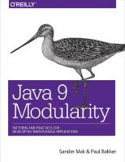
Java Modules General
Very interesting read (you’ll learn a lot more about modules than with this OCP exam):
Java 9 Modularity, O’Reilly, by Sander Mak and Paul Bakker

Slide 4
Java Modules General
Advantages
better access control
clearer dependency management
no more jar hell
custom code builds (smaller jdk)
increased security (custom code build > less code > less risk)
improved performance (no full class path scan required anymore)

Slide 5
Java Modules General
Disadvantages
using non modular code in a modular app
unit testing less straightforward (class path vs module path)
IDE hickups
CDI?
lack of support (frameworks, application servers,…)

Slide 6

OCP CH11 Modules
Definition
A group of one or more packages including a module-info.java file.

Slide 7
OCP CH11 Modules
module-info.java
must be in the root directory of your module
regular java classes should be in packages
the module name follows the naming rules for package names (like no dashes)
Notes:
Demo : place into /com and see what happens in IDE

Slide 8
OCP CH11 Modules
Question
Can a module file be empty?
Answer
Yes, just like a class file it can be empty.
Notes:
Demo, compile.

Slide 9
OCP CH11 Modules
Question
Which of the following is an advantage of the Java Platform Module System?
1. A central repository of all modules
2. Encapsulating packages
3. Encapsulating objects
4. No defined types
5. Platform independence
Answers: 2 (3 was already possible with private members)

Slide 10
OCP CH11 Modules
Keywords for module-info file
exports : lists a package you want to expose (can be used in other modules)
requires : lists the modules this module depends upon (access to the exported packages)
provides : specifies that a class provides an implementation of a service
uses : specifies that a module is relying on a service
opens : opens a package for reflection

Slide 11
OCP CH11 Modules
Question
Can you use the keywords from the module-info file in Java classes?
Answer
Yes.. but not as keywords! You can use them as variable / parameter names!
These keywords are actually called directives and only have a meaning in a module-info file.
Notes:
Demo, compile.

Slide 12
OCP CH11 Modules
Question
Can you limit access to an exported package?
Answer
Yes... by using to.
exports <packagename> to <module name>
Notes:
Of course… if you are writing a module for general use it is not smart to follow this approach. But if you have a module that you only want to be used inside a library that you are writing it can be useful.

Slide 13
OCP CH11 Modules
Question
Suppose module developer depends on module team and module team depends on module company. Fill in the blank so that code in module developer can access the company.guidelines package in module company.
module company {
________ company.guidelines;
}
export 2. exports 3. require
4. requires 5. require transitive
6. requires transitive 7. None of the above
Answer: 2

Slide 14
OCP CH11 Modules
Question
Given a module structure like below:
developer-feeding
module-info.java
exports feeding
developer-meetups
module-info.java
exports meetups
requires developer-feeding
developer-live
module-info.java
exports live
requires developer-meetups
Will this compile?
Notes:
Demo, compile.

Slide 15
OCP CH11 Modules
Answer
No. Module developer-live implicitly requires developer-feeding but the module-info of developer-live doesn't not specify a requires for developer-feeding.
developer-feeding
module-info.java
exports feeding
developer-meetups
module-info.java
exports meetups
requires developer-feeding
developer-live
module-info.java
exports live
requires developer-meetups
Notes:
Module developer-meetups requires module developer-feeding and this means that module developer-live implicitly requires developer-feeding as well. But as we can see the module-info of developer-live doesn't not specify a requires for developer-feeding.

Slide 16
OCP CH11 Modules
Question
Can we solve this?
No
Yes, by adding a requires developer-feeding to the module-info of developer-live
Yes, by add requires transitive developer-feeding to module-info of developer-meetups
Yes by factoring out the usage of modules

Slide 17

OCP CH11 Modules
Answer
B: Add requires developer-feeding to module-info of developer-live.
Or
C: Add requires transitive developer-feeding to module-info of developer-meetups.
Notes:
Of course can add a "requires developer-feeding" to the module-info of developer-live. But... the more modules you have and the more dependencies you have this will become unmanageable soon! This is where transitive requirements come in! If we specify "requires transitive developer-feeding" in the module-info of the developer-meetups module, that dependency will automatically be inferred by all modules requiring developer-meetups.

Slide 18
OCP CH11 Modules
Question
Will this compile?
module-info.java
exports live
requires developer-meetups
requires transitive developer-meetups
Answer
No. You can only require a module once.
Notes:
Demo, compile.

Slide 19
OCP CH11 Modules
Improved access control
Access level modifier | Within the module | Outside the module
private | Available only within class | No access
default (package-private) | Available only within package | No access
protected | Available only within package or to subclasses | Accessible to subclasses only if package is exported
public | Available to all classes | Accessible only if package is exported

Slide 20
OCP CH11 Modules
Module types
Named module : a (proper) java module
Automatic module : a regular jar on the module path
Unnamed module : a regular jar on the class path
Notes:
Named module: a module containing a module-info file.
Automatic module: a regular jar without a module-info file but placed on the module path.
- treated as if there were a module-info file
- all packages are exported
- automatic module name determination
- remove the file extension from the JAR name.
- remove any version information from the end of the name. A version is digits and dots with possible extra information at the end, for example, ‐1.0.0 or ‐1.0‐RC.
- replace any remaining characters other than letters and numbers with dots.
- replace any sequences of dots with a single dot.
- remove the dot if it is the first or last character of the result.
Unnamed modele : a regular jar without a module-info file but placed on the class path.
- it doesn't export any packaged to named/automatic modules
- it can read from any JAR on the class AND module path : the reason why all non-modular code runs on java9+

Slide 21
OCP CH11 Modules
Question
What happens if an unnamed module has a module-info file?
Answer
It simply will be ignored!
Notes:
Demo, compile.

Slide 22
OCP CH11 Modules
Modules provided by the JDK
names starts with "java" for standard java modules
names starts with "jdk" for jdk specific modules
Don't memorize them... but have a general feeling of their existence (for the exam).

Slide 23
OCP CH11 Modules
Services
Consist of:
an interface / abstract class decribing the service
any classes the interface references
some method of looking up implementations of the service
Note that implementations are not part of the service!
Notes:
To realise loose coupling, encapsulation, isolation.

Slide 24


OCP CH11 Modules
Example Service
Service
Module developer.api
module-info.java
exports developer.api
Module developer.pool
module-info.java
exports developer.pool; requires transitive developer.api; uses developer.api.Developer;
Module company
module-info.java
exports company; requires.developer.pool; requires developer.hipo;
Module developer.hipo
module-info.java
requires transitive developer.api provides developer.api.Developer with developer.hipo.ProDev;
Implementation
Notes:
Note: adding a new developer meanse you need to add a requires to the module company. This kind of violates the open/closed principle. Non modular java you just have to make sure that runtime the jar with the new developer implementation is available, mostly this will be achieved by adding a dependency to your pom.
Demo:
show code
compile and package all modules
run
All done by example-service.sh!

Slide 25
OCP CH11 Modules
Recap
Artifact | Part of service? | Directives required
Service provider interface | Yes | exports
Service provider | No | requires, provides
Service locator | Yes | exports, requires, uses
Consumer | No | requires
Important methods of the ServiceLoader (for the exam):
public static <S> ServiceLoader<S> load(Class<S> service) { … }
public Stream<Provider<S>> stream() { … }

Slide 26
OCP CH11 Modules
Command line compile commands
In the real world you would use a build tool but suppose you are not doing that...

Slide 27
OCP CH11 Modules
Compile a module
javac --module-path <mods dir> -d <target dir> <source files>
where
--module-path : directory where the module artifacts are stored
-d : target folder for the compiled code
Alternatives:
- --module-path -p

Slide 28
OCP CH11 Modules
Running the compiled code
java --module-path <mods dir> --module <mod name>/<app class>
where
--module-path : directory where the module artifacts are stored
--module : the module name + application class
Alternatives:
- --module-path -p
- --module -m

Slide 29
OCP CH11 Modules
Package a module
jar -cvf <target folder>/<jar name> -C <classes folder>
This is the same as before ☺

Slide 30
OCP CH11 Modules
Running the packaged code
java –-module-path <mods dir> --module <mod name>/<app class>
where
--module-path : directory where the module artifacts are stored
--module : the module name + application class
Alternatives:
- --module-path -p
- --module -m
Notes:
No difference in commands for running the compiled code… just… the actual module path you path might be different!

Slide 31
OCP CH11 Modules
Given a directory/module structure:
source
developer-api
module-info.java
exposes com.abnamro...;
com
abnamro
...
developer-feeding
module-info.java
exposes com.abnamro...;
com
abnamro
...
developer-meetups
module-info.java
exposes com.abnamro...;
requires developer-feeding;
com
abnamro
...
Notes:
Demo: example-compile-developer-api.sh
Note: the book lists the order of the source files is important… however we can’t reproduce that behavior!!!!

Slide 32
OCP CH11 Modules
Question
Would this compile (leaving out the module-path)?
javac -d target/developer-api
source/developer-api/com/abnamro/developer/api/*.java source/developer-api/module-info.java
Answer
Yes, because the developer-api module has no dependencies on any other module.
Notes:
Demo: example-compile-developer-api-without-mod-path.sh

Slide 33
OCP CH11 Modules
Question
Would this compile (leaving out the module-path)?
javac -d target/developer-meetups
source/developer-meetups/com/abnamro/developer/api/*.java source/developer-meetups/module-info.java
Answer
No, because the developer-meetups module has a dependency on the developer-feeding module.
Notes:
Demo: example-compile-developer-api-without-mod-path.sh

Slide 34
OCP CH11 Modules
Question
Would this compile… listing the module-info first?
javac --d developer-api
developer-api/module-info.java
developer-api/com.abnamro.developer.api/*.java
Answer
Theory says no… however…
Notes:
Demo: example-source-order-important.sh.
After compile, package it again and run the app again to proof it is fully functional!

Slide 35
OCP CH11 Modules
Describing a modules with the java command
java –p <mods dir> --describe-module <mod name>
Alternatives:
- --describe-module -d
Notes:
Notice the standard java and jdk modules. Notice java.base is always available.
Demo: describe-a-module-with-java-command.sh

Slide 36
OCP CH11 Modules
Listing all java modules with the java command
java –-list-modules
Listing all modules of the modules in a mods directory
java –p <mods dir> –-list-modules
Notes:
Notice the standard java and jdk modules. Notice java.base is always available.

Slide 37
OCP CH11 Modules
Showing the module resolution when running a program
java --show-module-resolution
-p <module path>
-m <module name>/<application class>
It will list some kind of module dependency tree/list when running the application
Notes:
Demo: running-with-module-resolution.sh.

Slide 38
OCP CH11 Modules
Describing a modules with the jar command
jar --file <mods dir>/<jar file> --describe-module
Alternatives:
- --file -f
- --describe-module -d
Notes:
Minor difference with the Java command, the module-info class is included in the output.
Demo: describe-a-module-with-jar-command.sh.

Slide 39
OCP CH11 Modules
View module dependencies using jdeps command
jdeps -summary -module-path <mods dir> <jar file>
Summary and module-path arguments are optional. It can list for each module the dependency on the packages in other modules.
Alternatives:
- -summary -s
Notes:
Demo: list-module-info-with-jdeps-command.sh.
Notice the difference using running with and without summary.

Slide 40
OCP CH11 Modules
Finding future problems
You shouldn’t use unsafe / internal packages! Ever!
jdeps --jdk-internals <jar file>
List any usage of internal classes. Will prevent you from compiling moving forward to newer Java versions! Module jdk.unsupported should never be in the required list!
Alternatives:
- --jdk-internals -jdk-internals
Notes:
Demo: list-module-info-with-jdeps-command.sh.
Notice the difference using running with and without summary.

Slide 41
OCP CH11 Modules
JMOD
With the JMOD command you can create, inspect, extract from JMOD files.
A JMOD file you can use to store any file that can’t be stored inside a JAR file.
That’s it about JMOD for the exam

Slide 42
OCP CH11 Modules
Migrating non modular applications
Bottom up
Create dependency graph of the packages / libs
Start with the package/lib that has no dependencies
Add module-info (with exports, requires)
Move to the module path
Repeat from 2

Slide 43
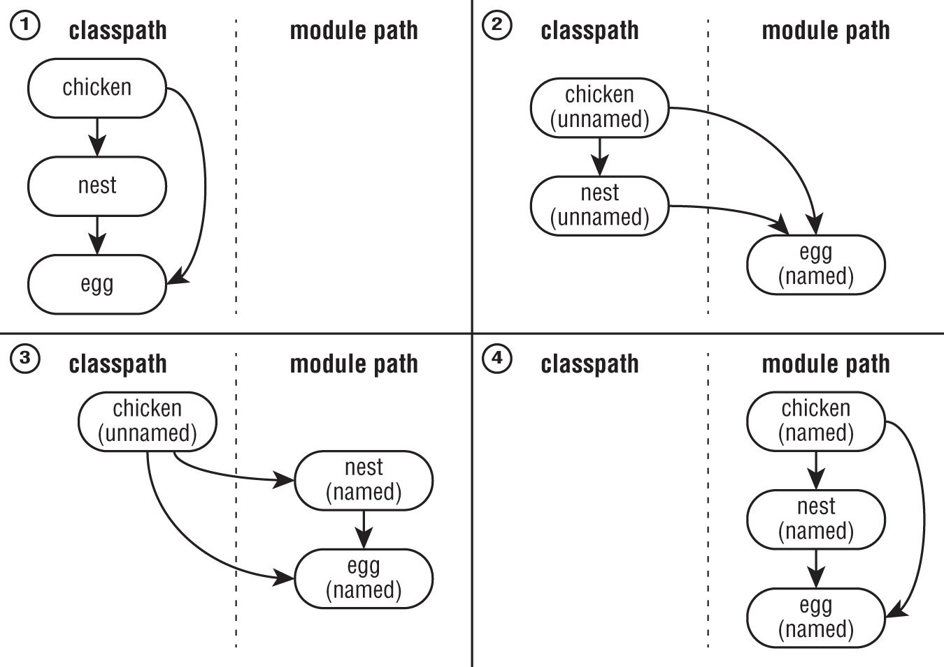
OCP CH11 Modules

Slide 44
OCP CH11 Modules
Top down
Create dependency graph of the packages / libs
Put all packages / libs on the module path
Select the highest level that has not yet been migrated
Add module-info (with exports, requires)
use the automatic derived names for the required modules
Repeat from 3

Slide 45
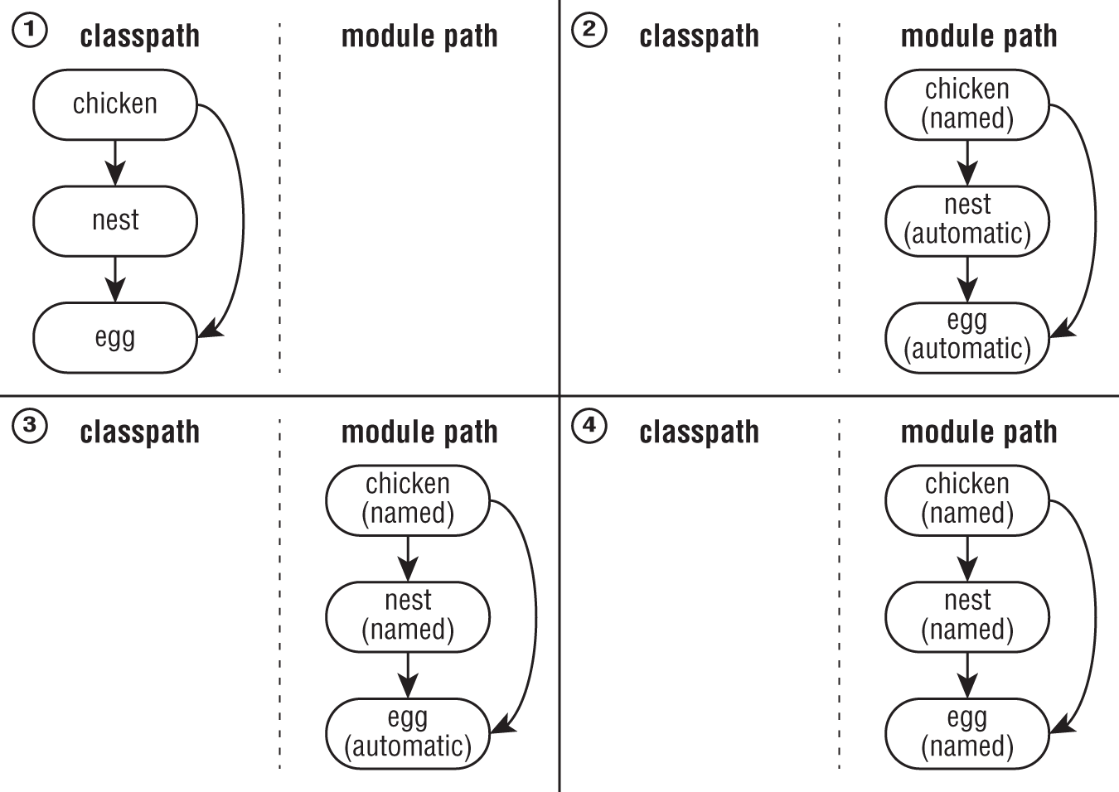
OCP CH11 Modules

Slide 46
OCP CH11 Modules
Migration strategies compared
Category | Bottom up | Top down
A project that depends on all others | Unnamed module on the classpath | Named module on the module path
A project that has no dependencies | Named module on the module path | Automatic module on the module path
Bottom up: when your are in control of all libs/jars.
Top down: when you are not in control of all libs/jars.

Slide 47
OCP CH11 Modules
Question
Will this copile?
Module moduleA
module-info.java
exports package.a
requires moduleB
Module moduleB
module-info.java
exports package.b
requires moduleA
Answer
No! Cyclic dependencies are not allowed between modules
Notes:
Demo: example-compile-developer-api-without-mod-path.sh

Slide 48
OCP CH11 Modules
?
?

Slide 49
OCP CH11 Modules
?
?

Slide 50
Done
Questions?

